Slide 1
JavaScript Fundamentals

Slide 2
Why Study JavaScript?
JavaScript is one of the 3 languages all web developers must learn:
1. HTML = Structure
2. CSS = Style
3. JavaScript = Script (Interactivity and Behavior)

Slide 3


Slide 4


Slide 6
const js = “free for everybody”;

Slide 7
JavaScript Fundamentals
Numbers and Math
Strings
Variables (include Scope)
Booleans and If-Statements
Functions
Events
Objects
Document Object Model (DOM)
Arrays
Loops

Slide 8
JavaScript Objects

Slide 9



Real life objects

Slide 10
Real life objects
Object | Properties phone.brand= iPhone 15 Pro phone.displaySize = 6.1 inches phone.displayType = rtx 4090 systemUnit.ram = 32gb DDR5 systemUnit.caseColor = white | Methods systemUnit.on() systemUnit.off()

Slide 11
JavaScript Variables
VS
JavaScript Objects
let age = 30;
let name = "John";
JavaScript objects can contain many values.
const person1 = {
name: "John",
age: 30
};
JavaScript variables are containers for data values.
Commonly, used to store and organize related data.
const students = [
{name: “Gracey”},
{name: “Gaeus”},
];
Can be used to create more complex data structures. (eg. Arrays)
It is a common practice to declare objects with the const keyword.
ASI, or Automatic Semicolon Insertion.

Slide 12
Object Properties
Property:Value pairs
Property | Value
firstName | Kevin
lastName | Durant
age | 35
eyeColor | black
Accessing Object Properties
You can access object properties in two ways:
objectName.propertyName called that dot.notation
or
objectName["property-name"] called the [“bracket-natation”]

Slide 13
Object Properties
The name:values (property-value) pairs in JavaScript objects are called properties:
Property | Property Value
firstName | Kevin
lastName | Durant
age | 35
eyeColor | black
Manipulating Object Properties
You can add object property:
objectName.propertyName; (does not exist in object)
You can delete object property:
delete objectName.propertyName;

Slide 14
Object Methods
They are functions that are associated with and defined within objects, and they allow you to perform specific operations or manipulations on the object's properties (data).
Methods are actions that can be performed on objects.
Methods are stored in properties as function definitions.
A method is a function stored as a property.
Accessing Object Methods
You access an object method with the following syntax:
objectName.methodName()
If you access a method without the () parentheses, it will return the function definition…

Slide 15
JavaScript HTML DOM

Slide 16
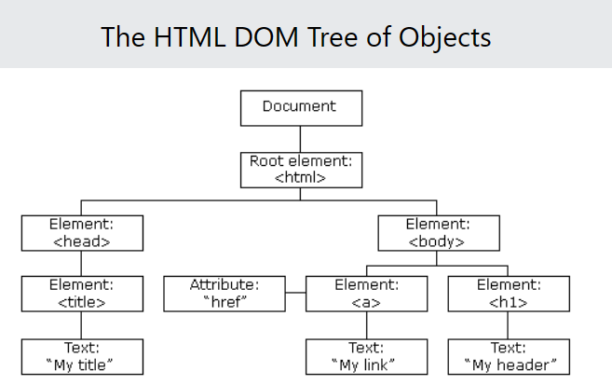
The HTML DOM (Document Object Model)
When a web page is loaded, the browser creates a Document Object Model of the page.
DOM = another built-in object in JS(like console, Math, JSON, localStorage) → access using document

Slide 17
The HTML DOM (Document Object Model)
With the object model, JavaScript gets all the power it needs to create dynamic HTML:
JavaScript can change all the HTML elements in the page
JavaScript can change all the HTML attributes in the page
JavaScript can change all the CSS styles in the page
JavaScript can remove existing HTML elements and attributes
JavaScript can add new HTML elements and attributes
JavaScript can react to all existing HTML events in the page
JavaScript can create new HTML events in the page

Slide 18
The HTML DOM (Document Object Model)
With the object model, JavaScript gets all the power it needs to create dynamic HTML:
JavaScript can change all the HTML elements in the page
JavaScript can change all the HTML attributes in the page
JavaScript can change all the CSS styles in the page
JavaScript can remove existing HTML elements and attributes
JavaScript can add new HTML elements and attributes
JavaScript can react to all existing HTML events in the page
JavaScript can create new HTML events in the page

Slide 19
JavaScript - HTML DOM Methods
The HTML DOM can be accessed with JavaScript (and with other programming languages).
In the DOM, all HTML elements are defined as objects.
The programming interface is the properties and methods of each object: <html> <body> <p id="demo"></p> <script> document.getElementById("demo").innerHTML = "Hello World!"; </script> </body> </html>
A method is an action you can do (access or find an HTML element).
A property is a value that you can get or set (like changing the content of an HTML element).

